Slide 1

Automating Diagram Generation: Translating Natural Language with LLMs

Slide 2




Team Members
Aamish Samotra
Akshita Arora
Lida Wei
Shambhavi Singh

Slide 3

Agenda
Introduction & Project Goals
Challenges and Learnings
Background & Problem Statement
Future Scope
Methodology Overview
Conclusion
Dataset Creation and Fine-Tuning
Diagram Generation Workflow
Results and Evaluation

Slide 4
Introduction
Visualizing infrastructure enhances understanding, troubleshooting, and stakeholder communication
Objective: Automate translation of textual descriptions into accurate, visual architecture diagrams.
Leveraged AI techniques: Prompt engineering, rule-based logic, and LLM fine-tuning.

Slide 5
Project Goals
Automation
Accuracy
Contextual
understanding
Evaluation
Framework
Convert textual
descriptions into visual diagrams automatically
Ensure correctness using domain-specific logical rules
Fine-tune LLMs using structured synthetic datasets
Establish clear metrics for comparing prompting and fine-tuning methods

Slide 6
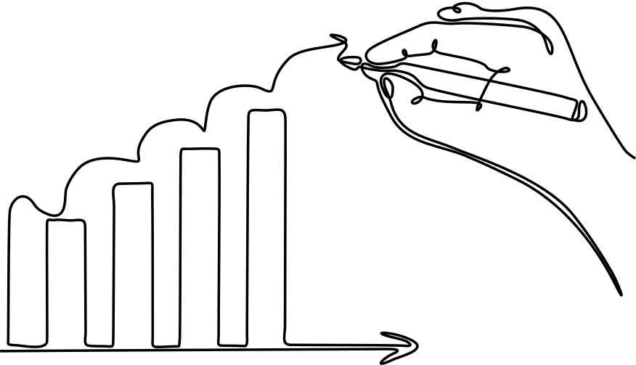
Background & Problem Statement
Manual diagram creation is time-consuming, error-prone, and challenging for non-technical stakeholders.
Traditional tools (AWS icons, Lucidchart) lack dynamic scalability
Need for automated, flexible diagram generation aligning with modern Infrastructure-as-Code practices

Slide 7

Types of Diagrams
Database Diagrams
Functional
Diagrams
Networking Diagrams

Slide 8
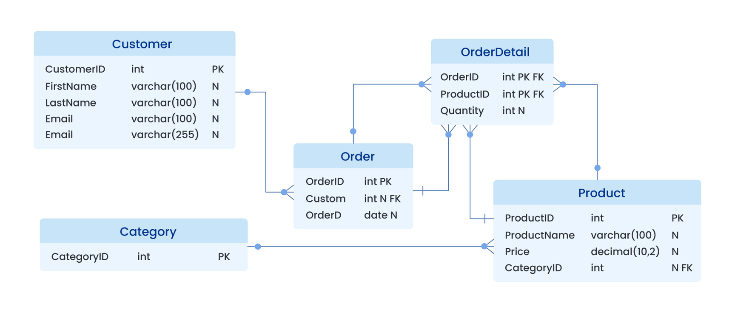
Database Diagram

Slide 9
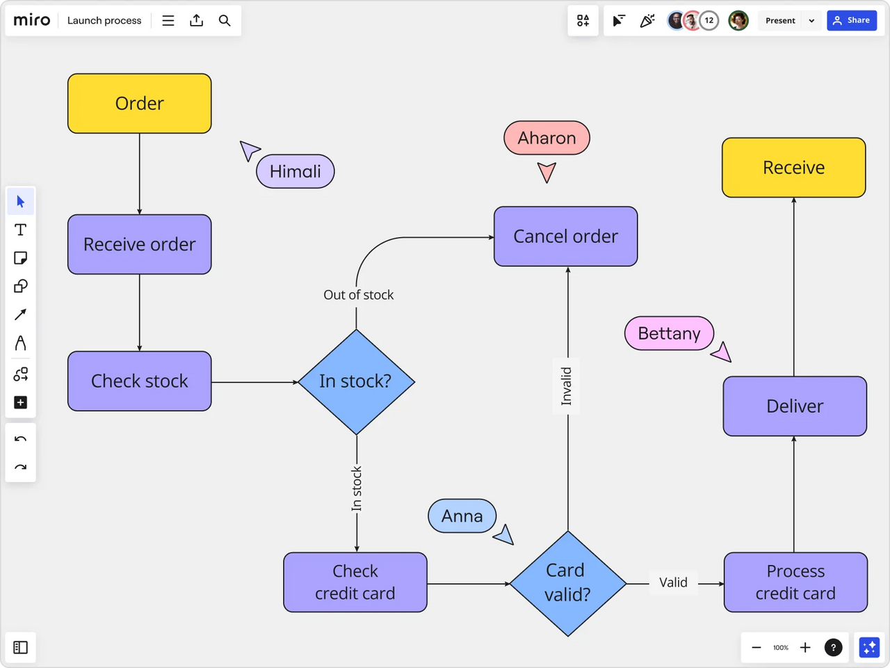
Functional Diagram

Slide 10
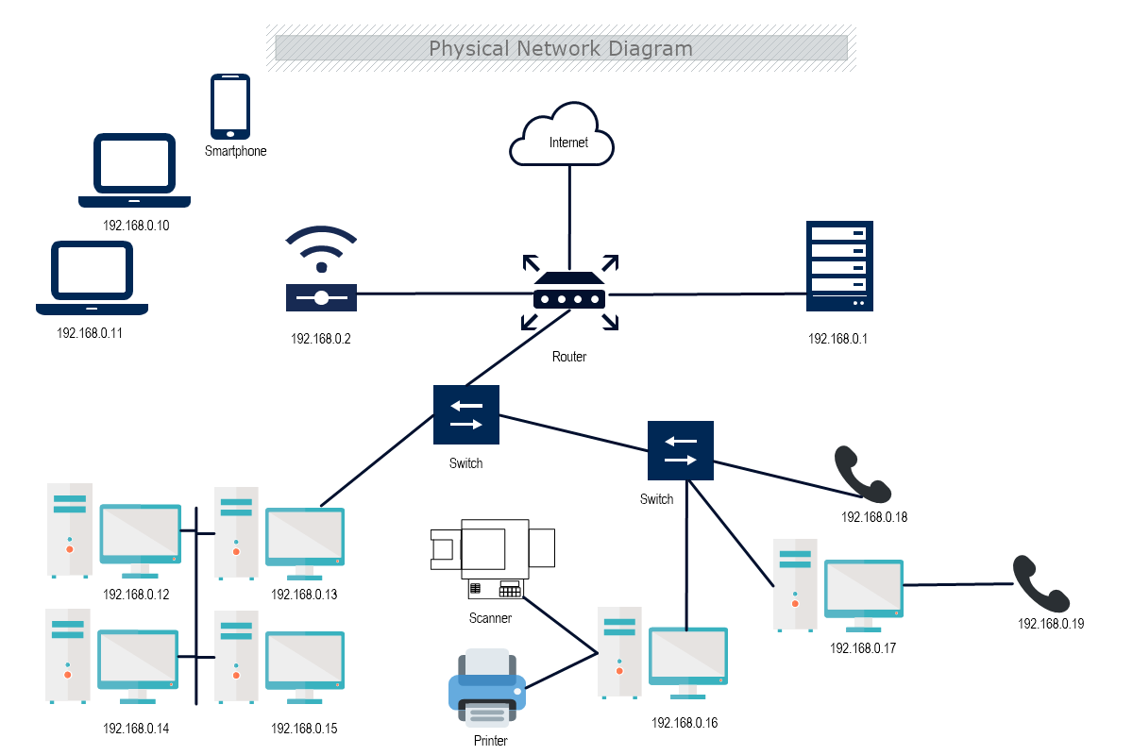
Networking Diagram

Slide 11
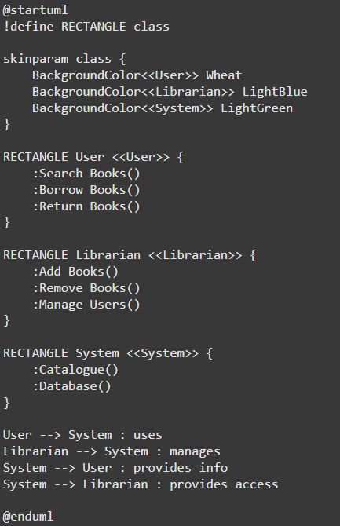
Example Output
Input: “Create a class diagram for a library system with classes for Book, Library, and Member.”

Slide 12
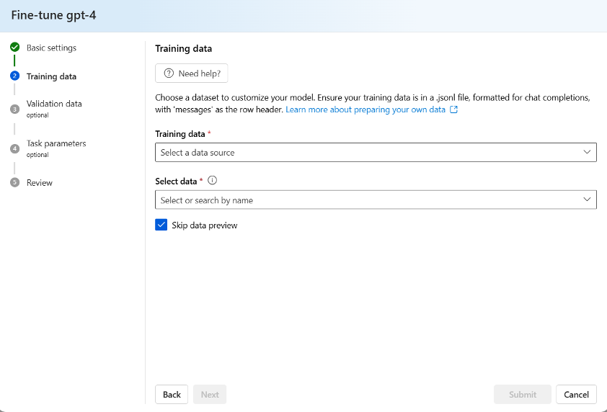
Fine-tune LLM

Slide 13
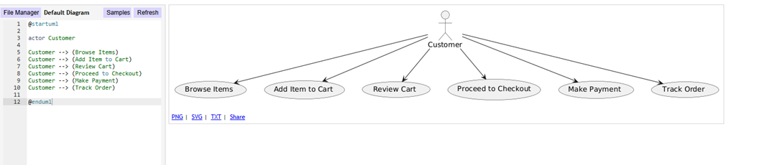
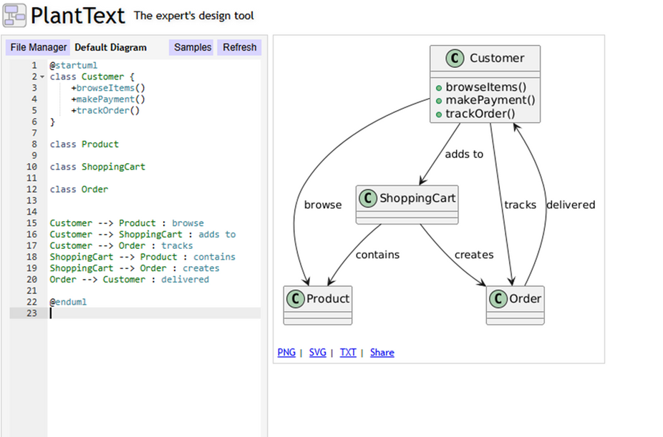
Low Level of Detail
Before fine-tuning
After fine-tuning

Slide 14
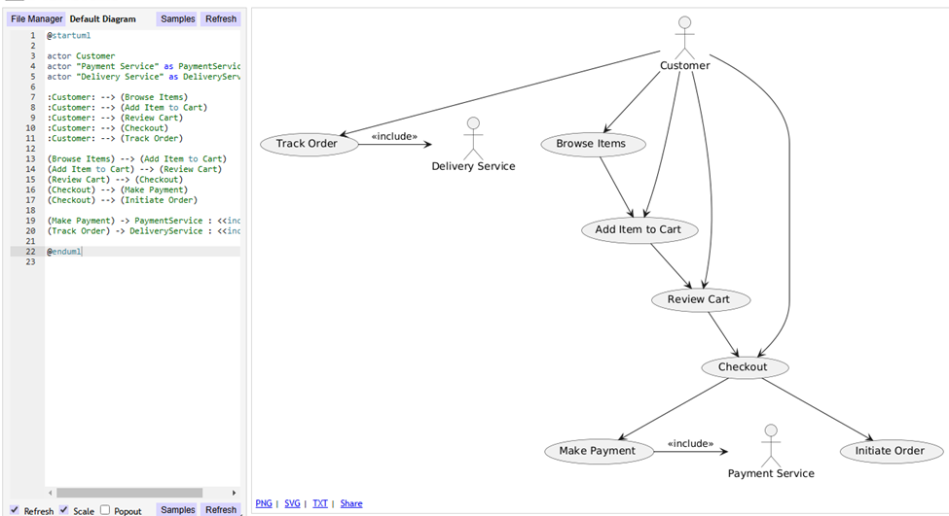
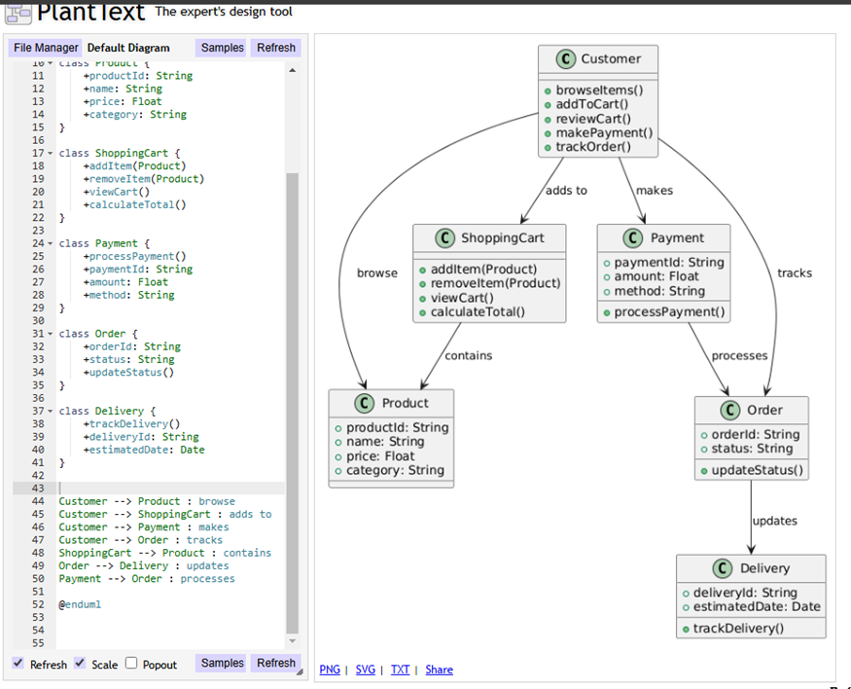
High Level of Detail
Before fine-tuning
After fine-tuning

Slide 15
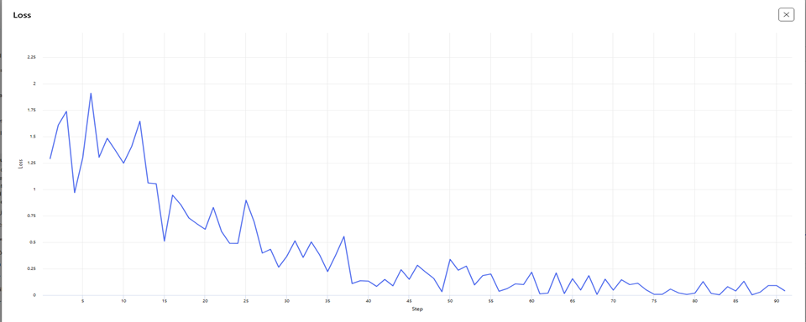
Model Training
Training Loss: A measure of how well the model is learning to predict the desired outputs (completions) from the provided inputs (prompts) during the training process.

Slide 16
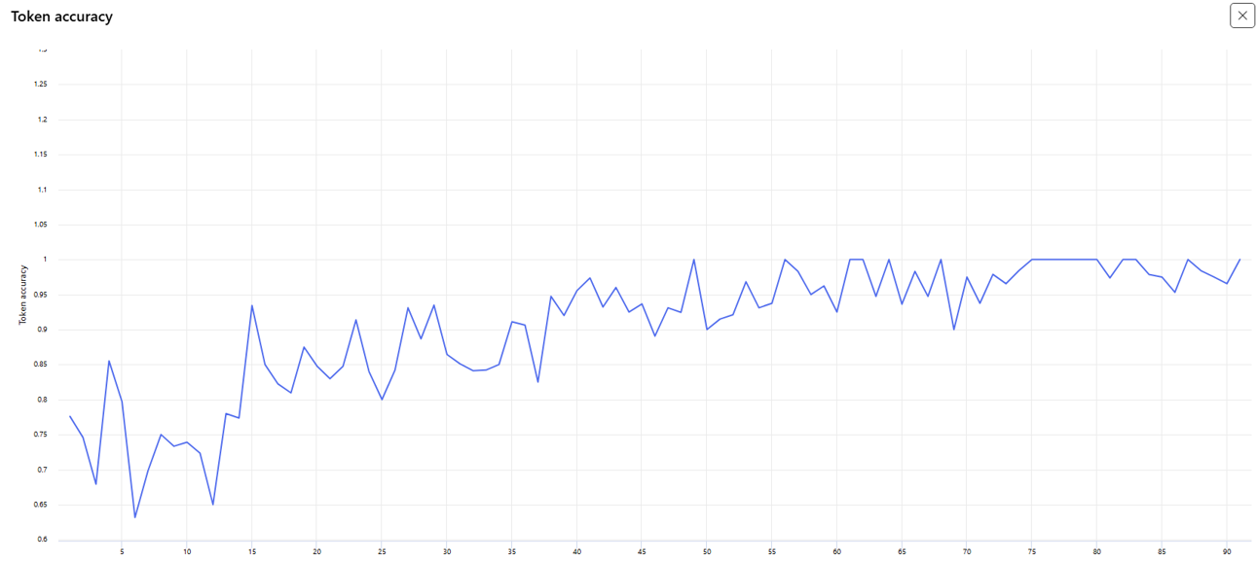
Model Training
Token accuracy: measures how often the model correctly predicts the next token (word piece, character, or word) during training.

Slide 17
Methodology
Overview
Rule-Based
Transformation
Fine-Tuning LLMs
Prompt Engineering
Structured, hierarchical prompts tailored for infrastructure
Logical rules based on best practices
Enhanced contextual understanding of components and relationships

Slide 18
Synthetic Dataset Creation
Component-Level Dataset
Ports, security groups, IP protocols,NAT, routing rules, encryption settings

Slide 19
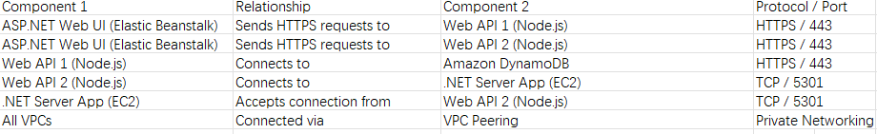
Synthetic Dataset Creation
Relationship-Level Dataset
VPC communication rules, routing paths, firewall permissions, and redundancy

Slide 20
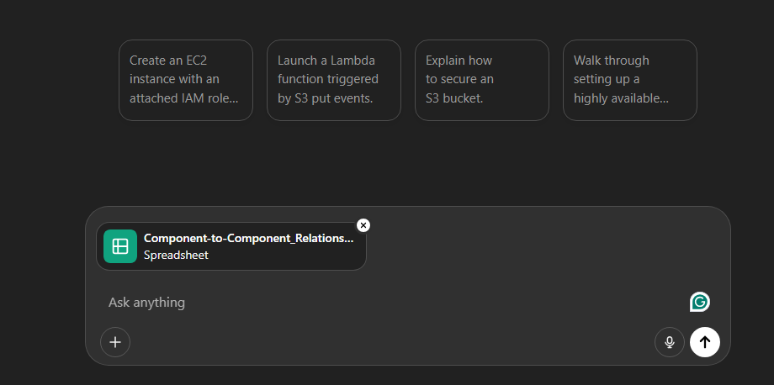
Diagram Generation Workflow
Input structured textual description (Excel sheets or prompts)

Slide 21

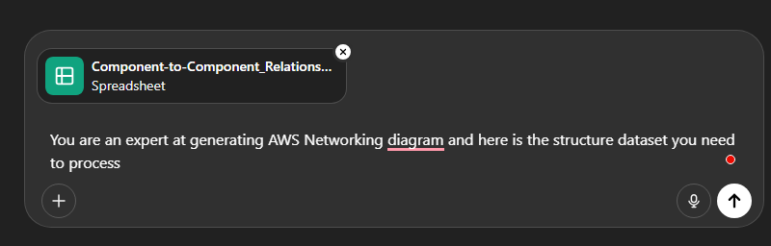
Generate a Mermaid.js diagram using either:
Prompt-based inference

Slide 22
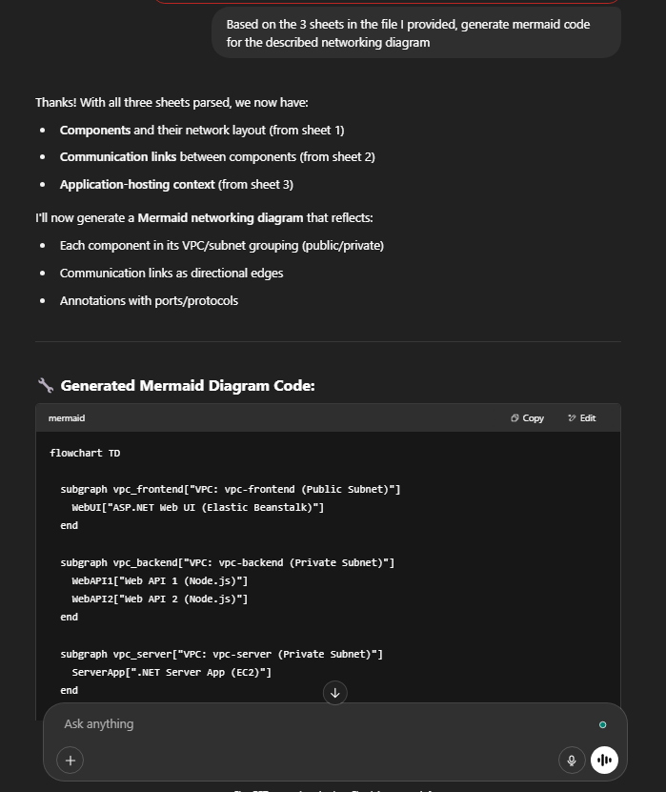
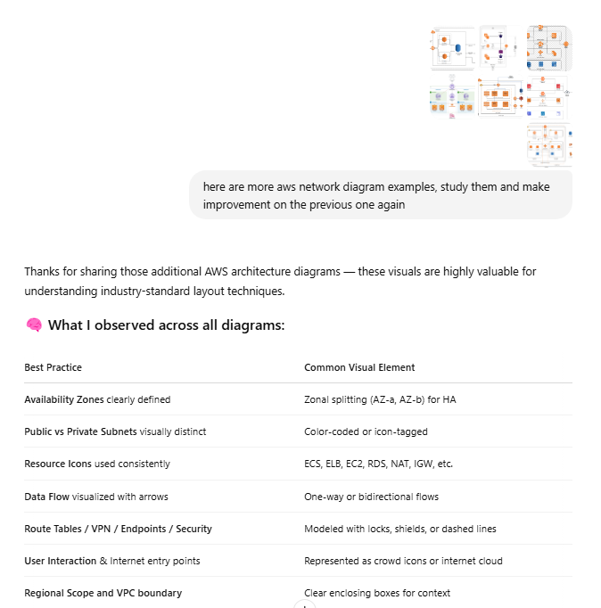

Slide 23
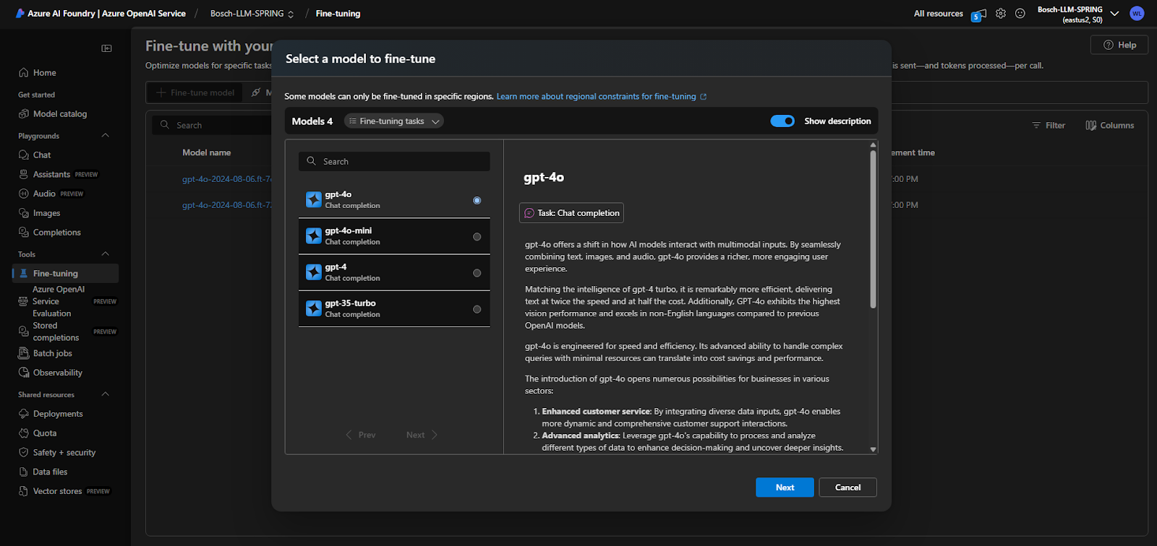
Fine-tuned LLM output

Slide 24
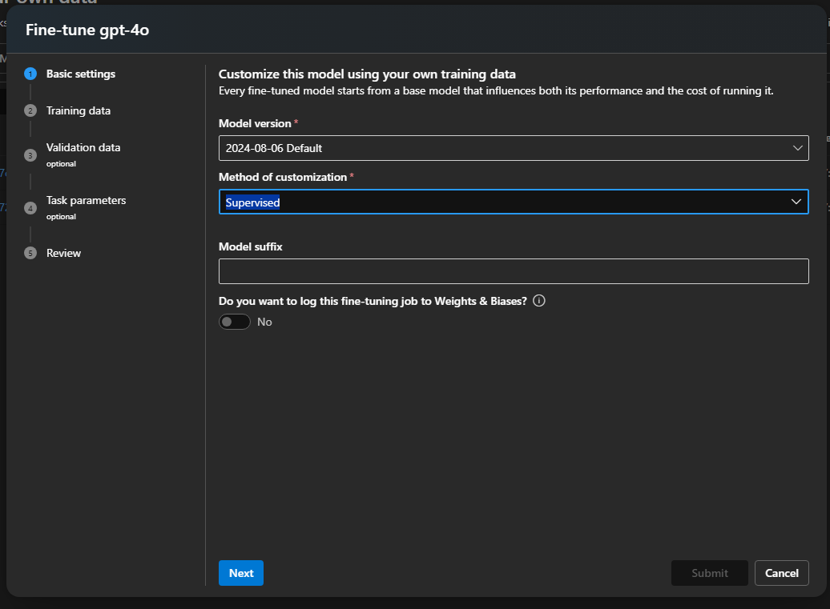

Slide 25
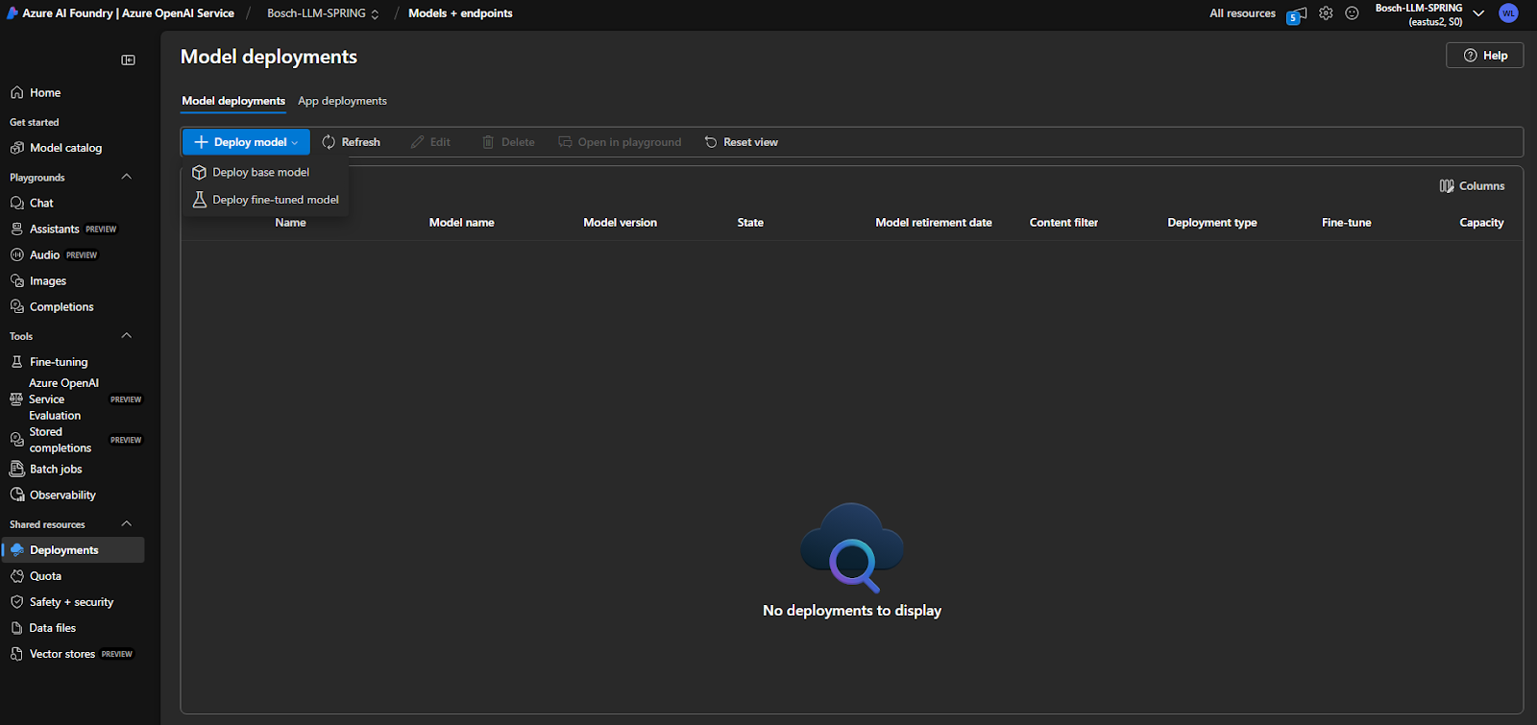

Slide 26
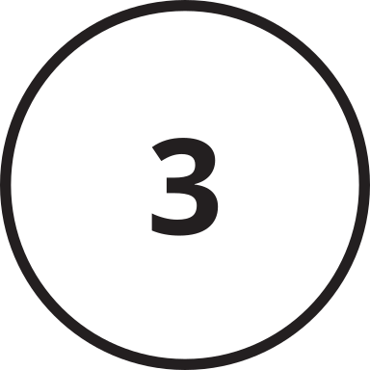
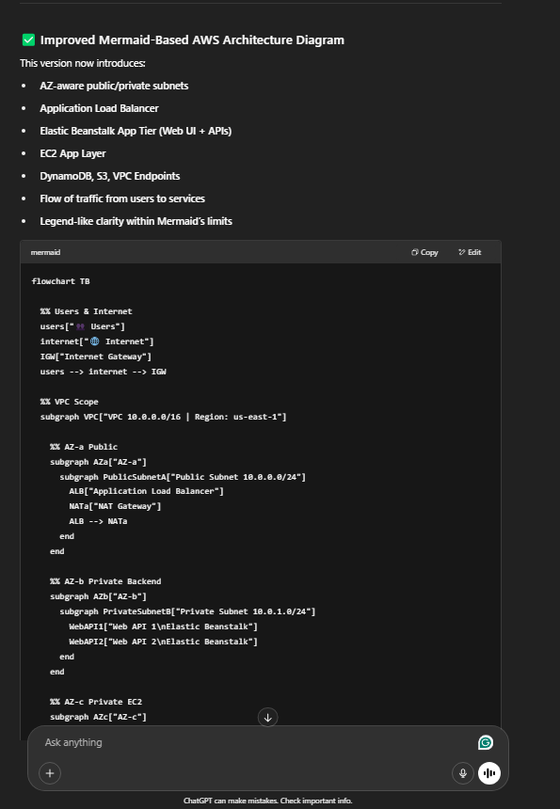
Render Mermaid.js syntax
into visual networking diagrams

Slide 27

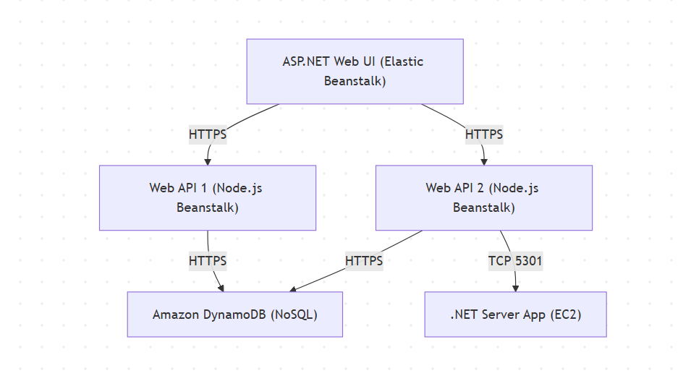
Validate diagrams against official AWS architecture references

Slide 28
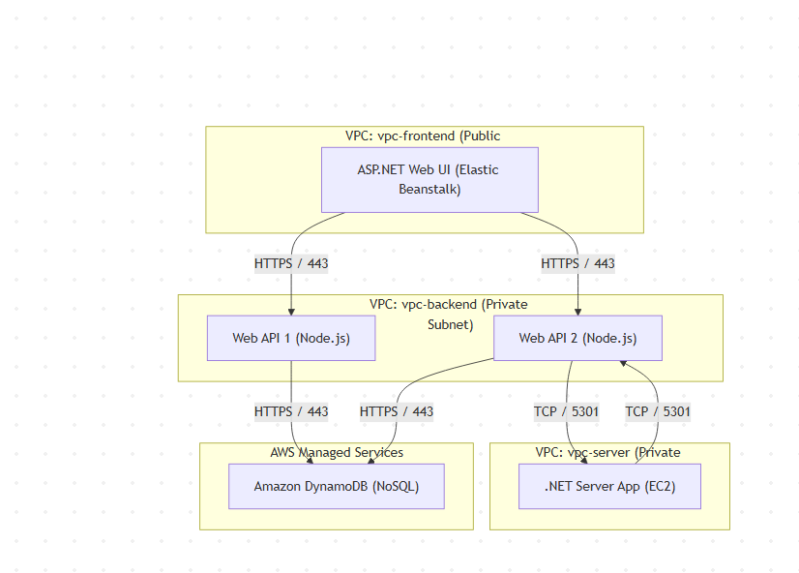

Slide 29
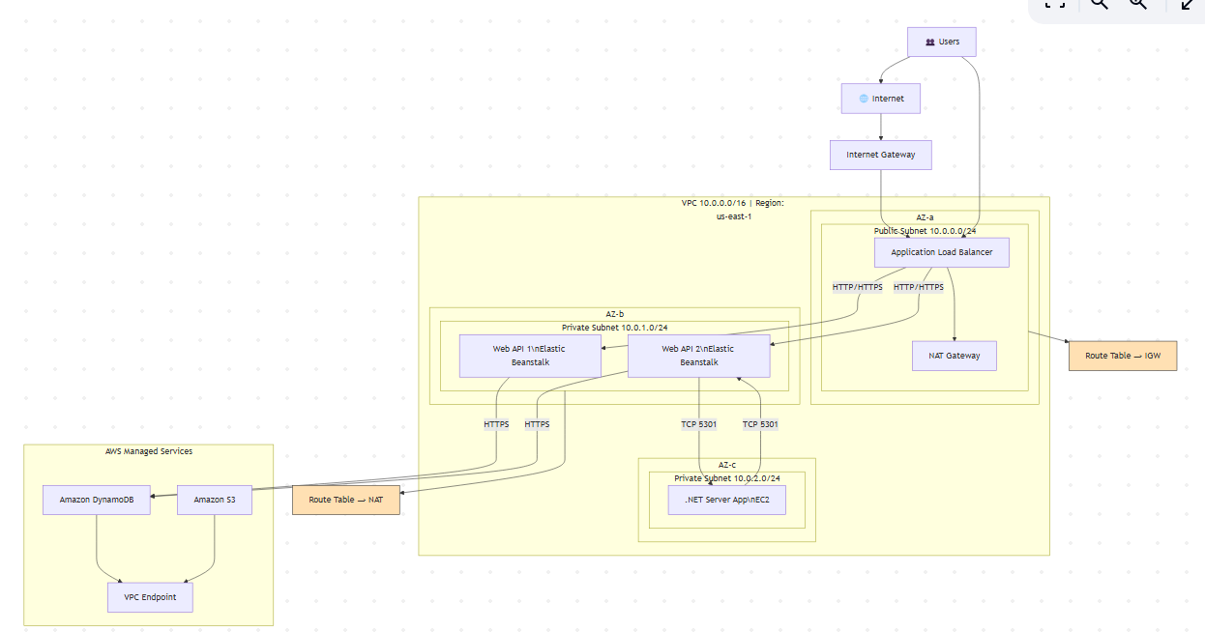
Our final
version

Slide 30
Results & Evaluation Metrics
Syntax Validity:
Ensured outputs compile
into valid Mermaid diagrams
Consistency:
Repeated accuracy across similar prompts
Structural Completeness:
Components and connectivity
accurately depicted

Slide 31
Technique Evaluation
Prompting
Rule Based
Fine-tuning
Fast iteration
Deterministic
Strong generalisation
Strengths
Reusable templates
High accuracy
Better context
Limitations
Inconsistent with edge cases
Labor-intensive rule updates
High compute cost, overfitting risks

Slide 32







Monthly Ad Performance Report
Peformance
Comparison
Fine-tuned outputs
Validation tests
85%
Review of top-performing
ad creatives and their impact.
Prompt-Only Outputs
Correctness Tests
60%

Slide 33
Before vs. After Fine Tuning
Before Fine-Tuning
After Fine-Tuning
Enhanced detail, clear network relationships, improved component placement.
Improved visualization of security groups, routes, and subnet layers.
Low-detail, limited clarity in complex scenarios.
Inconsistent labeling and relationships.

Slide 34


Challenges:
Model Selection: Balancing generative power and domain-specific accuracy
Semantic Conflicts: Confusion between similar AWS services (e.g., EC2 vs. Fargate)
Mermaid Limitations: Limited icon sets restricted visual clarity
Dataset Over-Specification: Excessive detail led to inaccuracies
Learnings:
Pre-trained generative models (e.g., GPT-4) are strong foundations for fine-tuning
Challenges & Learnings
Dataset structure directly impacts model accuracy and generalizability

Slide 35



Future Scope and Recommendations
Multi-Cloud Expansion: Include Azure and GCP-specific diagrams
Dynamic Prompt Builder: GUI-based prompt creation for users
CI/CD Integration: Automate diagram generation in DevOps pipelines (e.g., GitHub Actions)
Connor Hamilton
Explainability Layer: Trace model outputs to explain diagrammatic
decisions clearly

Slide 36
Conclusion
Successfully demonstrated automated diagram generation via AI
Integration of structured datasets, rules, and fine-tuned models significantly reduced manual effort
Hybrid strategy (prompt engineering + fine-tuning) offers flexibility, accuracy, and scalability
Connor Hamilton
Enhanced productivity and reduced manual diagram creation tasks for DevOps, architects, and analysts

Slide 37
Thank you
For your attention
Acknowledgments:
Thank the Bosch team for continuous feedback and guidance
Prof. Ashish Khandelwal for the opportunity and support

